Slide 1



MEMORY MATRIX
Presented by Group 1
Group members :
Yograj Tare - 58
Vitthalrao Zende - 68
Divyesh Rawat - 43
Pranjal Saha - 44

Slide 2
MOTIVATION
To understand basic microcontroller programming and GPIO control
To learn how LED patterns simulate real-world systems (like signals, indicators)
To develop a simple interactive system (Memory Matrix concept)
To improve logical thinking and pattern design skills
To gain hands-on experience with hardware + software integration
To explore how inputs (button/joystick) control outputs (LEDs)
To build a low-cost and beginner-friendly embedded system project
To understand the concept of memory-based pattern recognition (Memory Matrix)

Slide 3

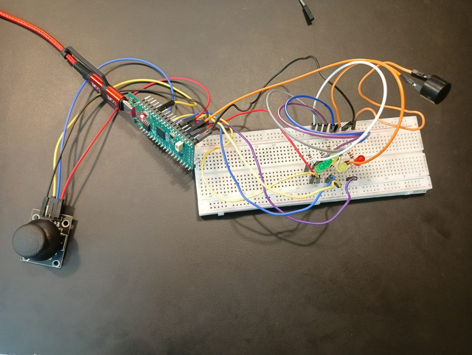
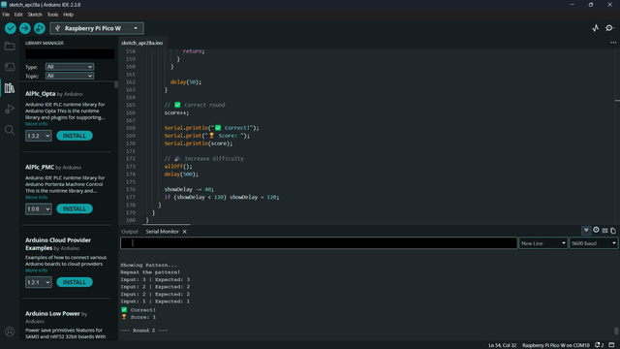
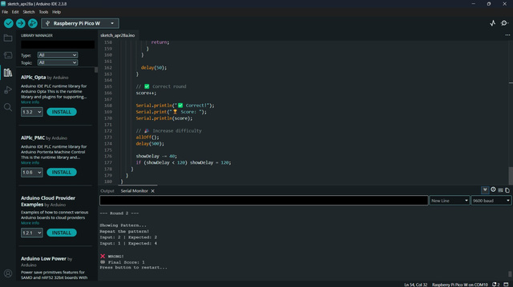
WORKING
System is powered using USB supply
Raspberry Pi Pico initializes GPIO pins
LEDs are connected as output devices through resistors
Program starts with a default LED pattern
Microcontroller sends HIGH/LOW signals to control LEDs
LEDs glow in specific sequences (patterns)
User input (button/joystick) is read by the controller
Based on input, pattern or speed changes
Patterns repeat continuously in a loop
In Memory Matrix mode, user observes and repeats LED sequence

Slide 4
CHALLENGES FACED
Difficulty in understanding GPIO pin configuration
Managing correct wiring on breadboard (loose/incorrect connections)
Ensuring proper current limiting for LEDs (resistor selection)
Creating accurate timing delays for smooth LED patterns
Debugging wrong or unexpected LED sequences
Handling multiple LEDs simultaneously
Integrating input devices (button/joystick) with output
Voltage reading for Joystick was 5.5 V but it operates on 3.3 V
LCD was not working even it was connected with ESP32

Slide 5
RESULTS OF USING OUR PRODUCT
LEDs successfully displayed random light patterns
Users were able to observe and memorize sequences
Most users could repeat short patterns easily
Difficulty increased as pattern length increased
Improved memory and concentration skills of users
System responded correctly to user inputs
LED patterns were smooth and clearly visible
Game was interactive and engaging
Achieved objective of testing memory using LED sequences

